Slide 1
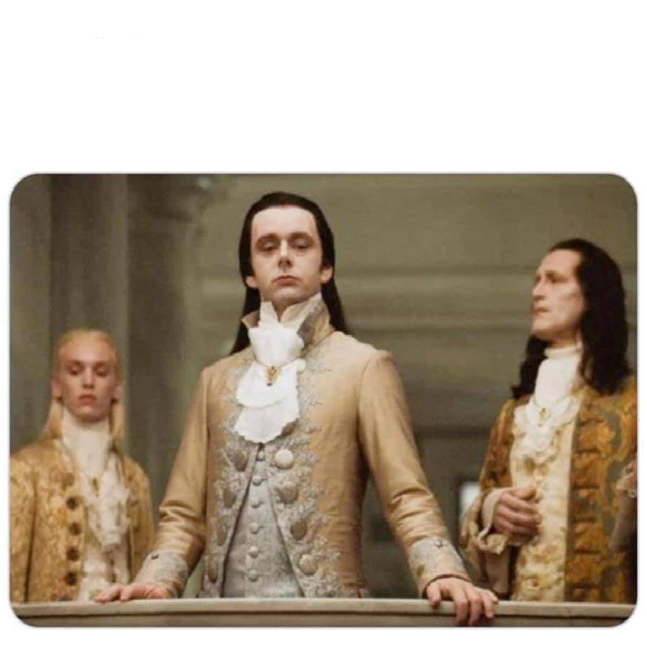
Alexandre Le Grand

Slide 2
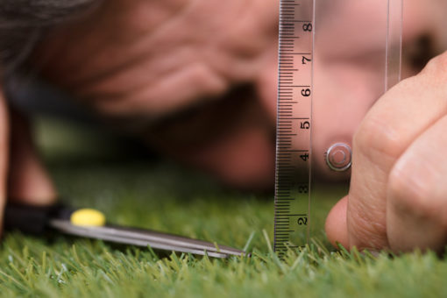
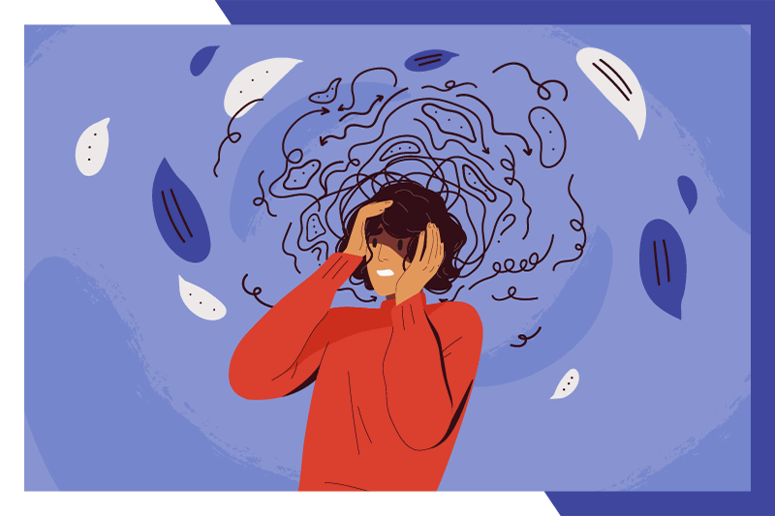
Name and nicknames : Alexandre / alex
What would you describe you the best?
Perfectionist
Chaotic sometimes :
stress over little things

Slide 3



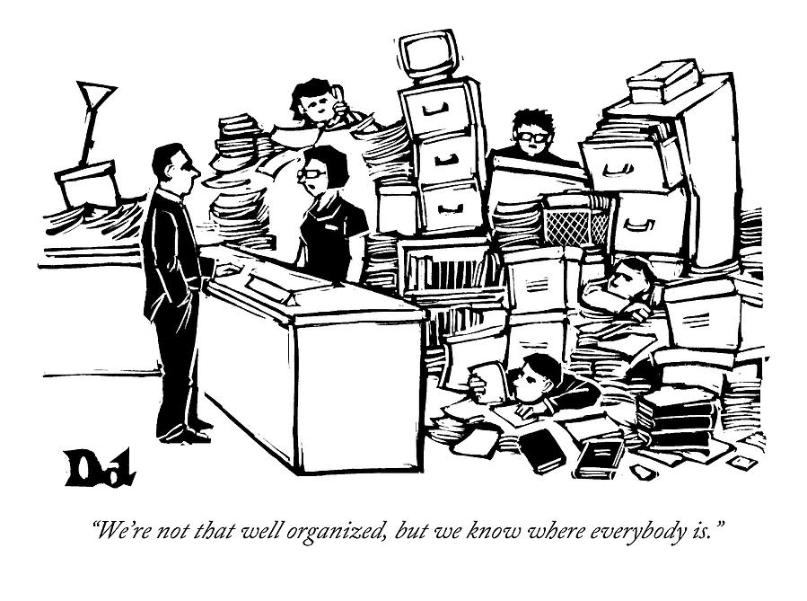
Dedicated / motivated
Disorganized

Slide 4

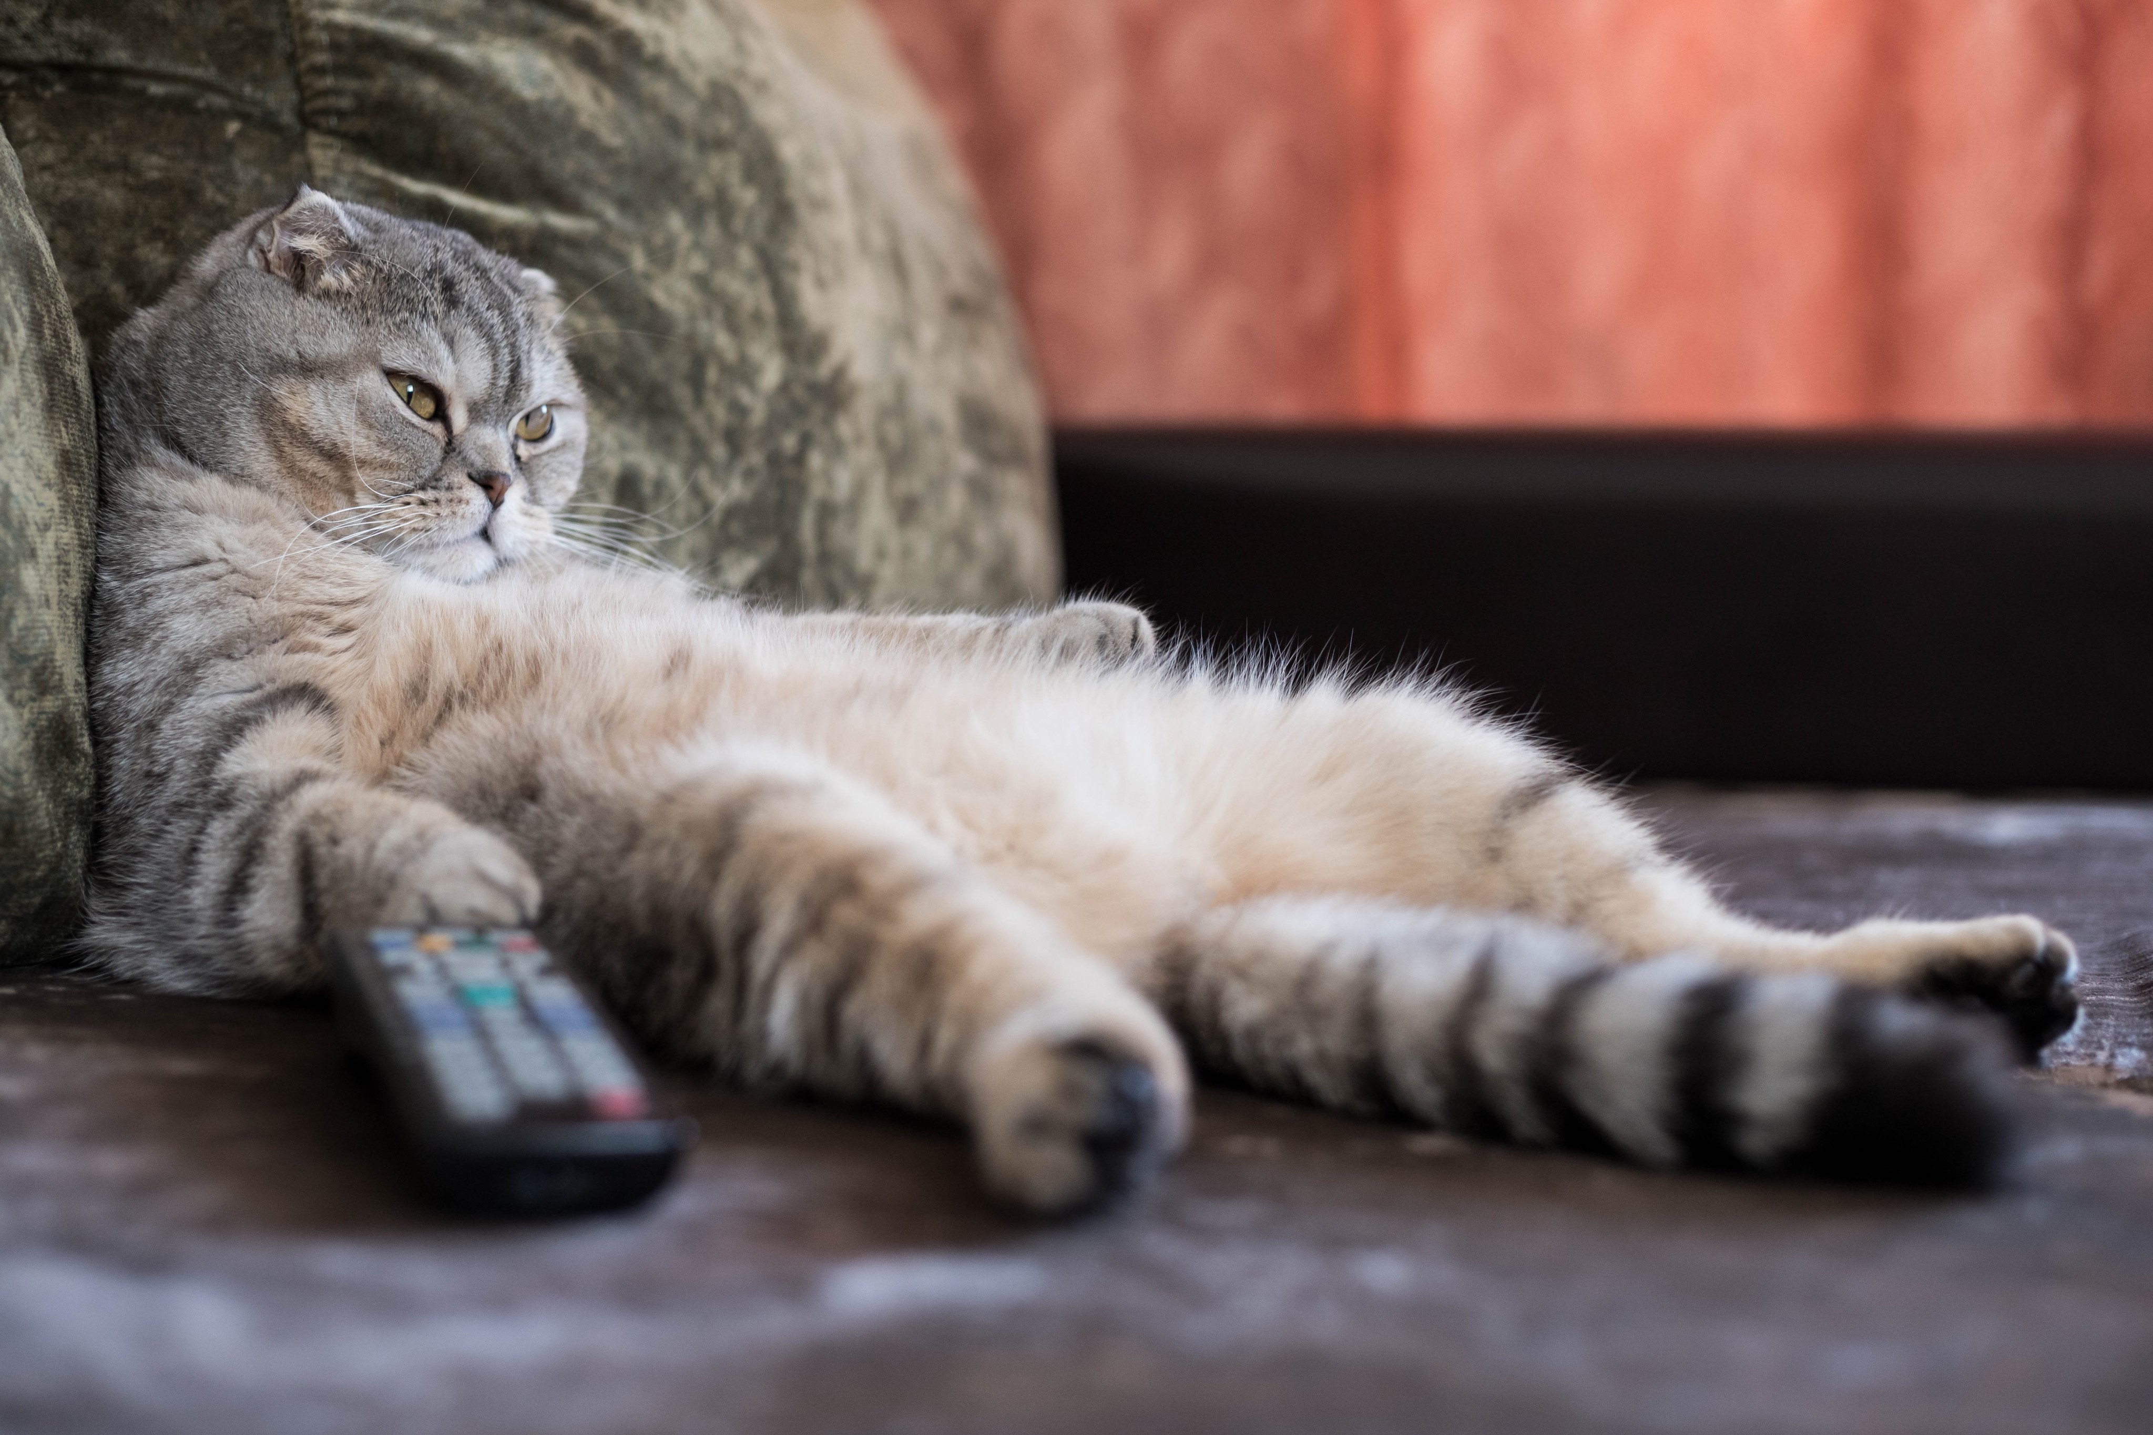
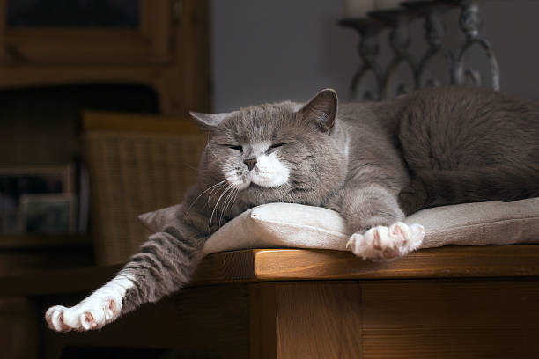
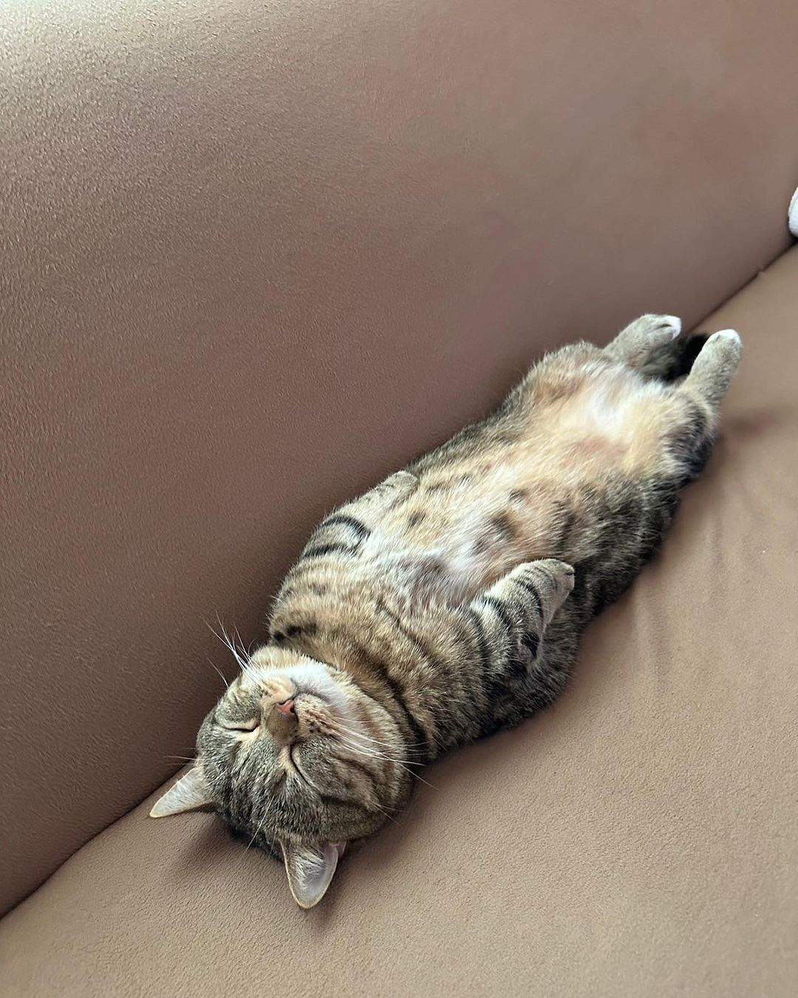
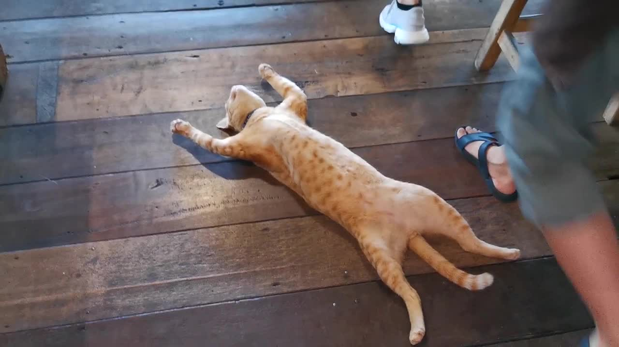

If you could compare yourself with any animal, object, color, movie, music or anything else which would it be and why?

Slide 5
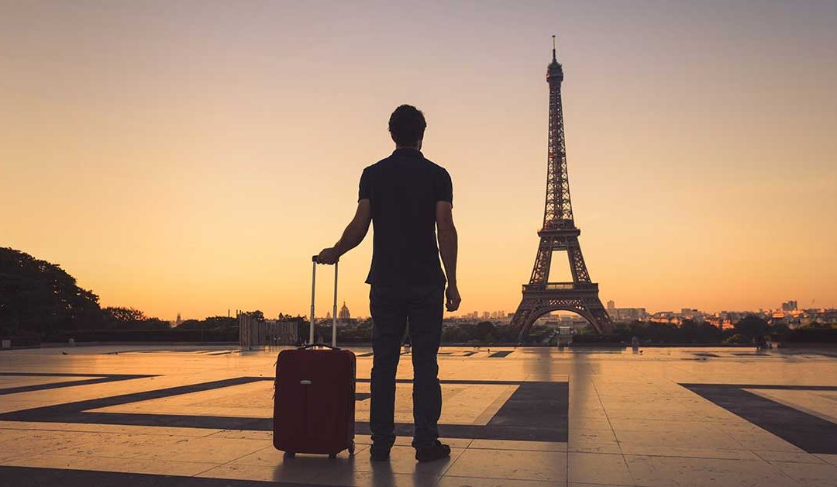
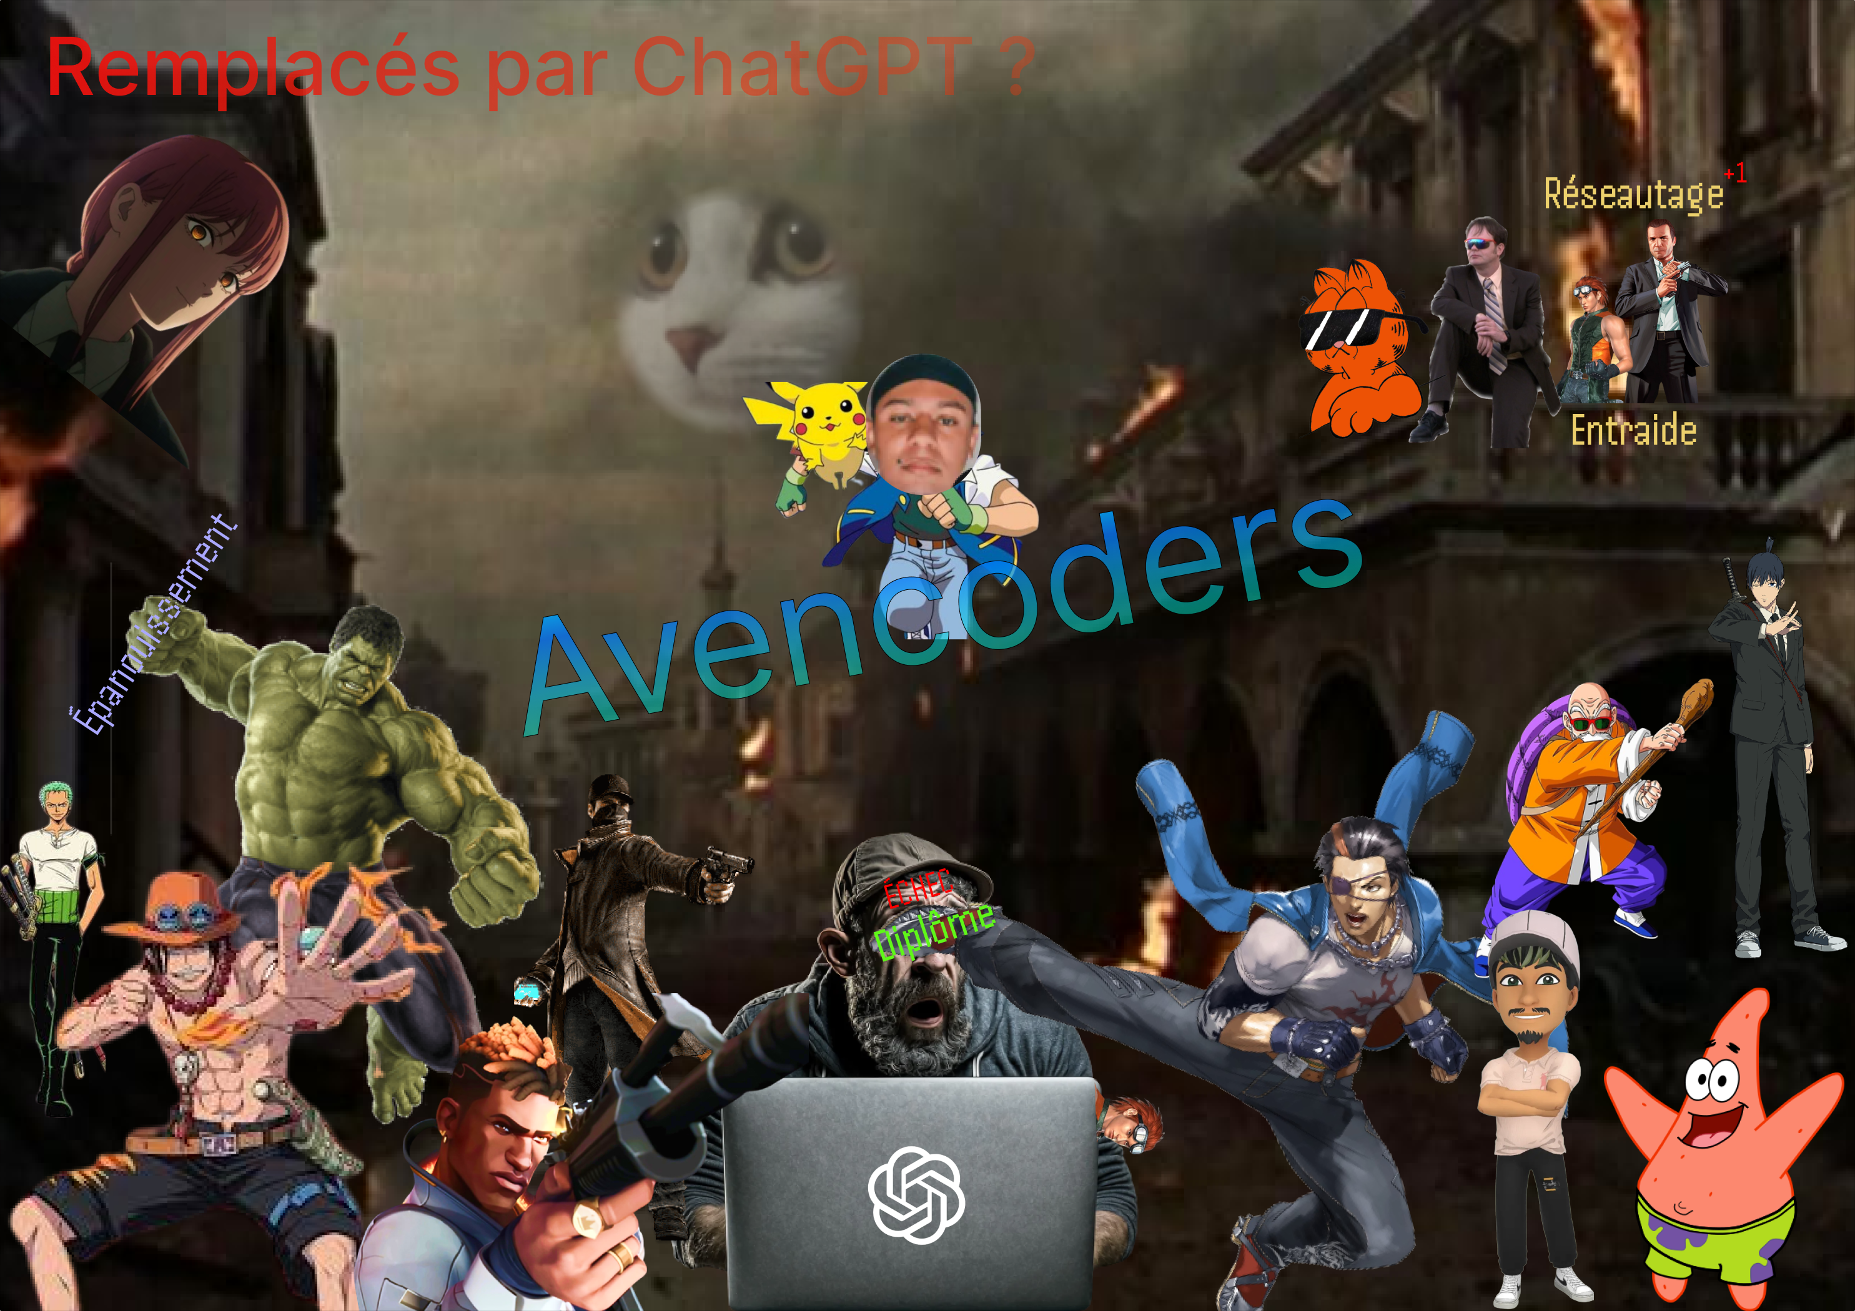
Name at least 2 noteworthy events in your life?
Moving to france
The day he met this amazing class

Slide 6
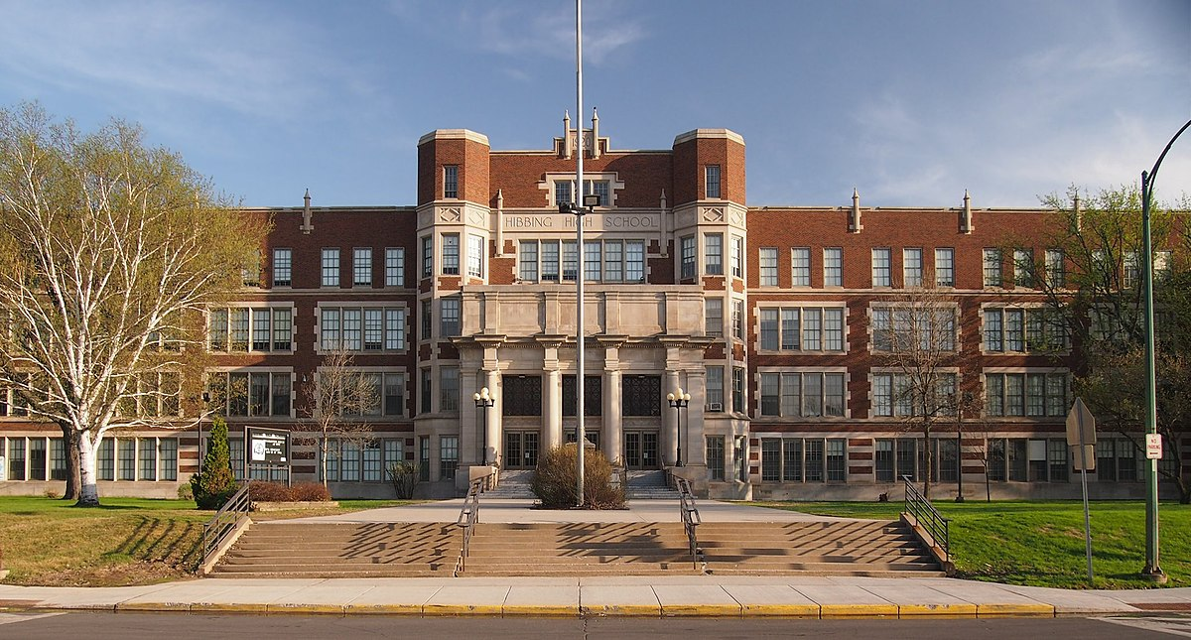

A bit of background?
3 years doing multimedia technician degree
Moved to France and did some intership

Slide 7

Tell an anecdote about you!
First time trying to make chicken soup :
He put the chicken soup in a pressure cooking pot
realised his mistake when it started boiling
Tried to open it without cooling the soup, and BOOM!!!
It exploded and burned him (RIP the chicken tho)
Then he called his mom about the incident and told her he’s gonna try again
« I’m burning, but it’s fine !! »

Slide 8


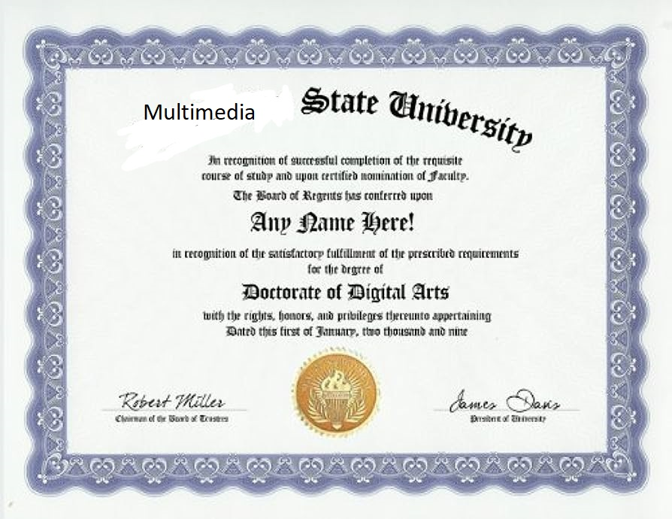
What is your experience in IT?

Slide 9

If I say “English”, what do you say?

Slide 10

Your plans for the future?

